Slide 1

IT5002
Computer Systems and Applications
Lecture 14
Inter-Process Communication
colintan@nus.edu.sg

Slide 2
Learning Objectives
By the end of this lecture you will be able to:
  Understand what race conditions are, and why they are bad.
  Understand the various ways to prevent race conditions.
  Understand how to pass messages between processes.
Some example code are taken from ArdOS, the Arduino Operating System.
  Simple kernel code.
  Obtainable from http://www.bitbucket.org/ctank/ardos-ide

Slide 3
Introduction
In the lecture we looked at how multiple processes can run on a single CPU.
In real-world applications, there are “dependencies” between processs.
  Process B cannot proceed because it is waiting for Process A’s result.
  Process B and Process A update the same shared variable, which can result in errors.
  …

Slide 4
Introduction
If both Process A and Process B are allowed to run freely, errors will occur.
  Process B proceeds before Process A completes, resulting in B using stale results.
  Process A and B update a variable at the same time, causing one process to over-write the results of the other process.
  Etc.
Some form of coordination is therefore required!
Material from this course comes from different places.
  Some books use “process” and some use “task”.
  Just remember that they mean the same thing.

Slide 5
Race conditions and critical sections
Inter-Process Communications

Slide 6
Race Conditions
Race conditions occur when two or more processes attempt to access shared storage.
  This causes the final outcome to depend on who runs first.
  “Shared storage” can mean:
    Global variables.
    Memory locations.
    Hardware registers.
      - This refers to configuration registers rather than CPU registers.
    Files.
  To understand race conditions, we will consider the example of a queue in a print spooler.

Slide 7
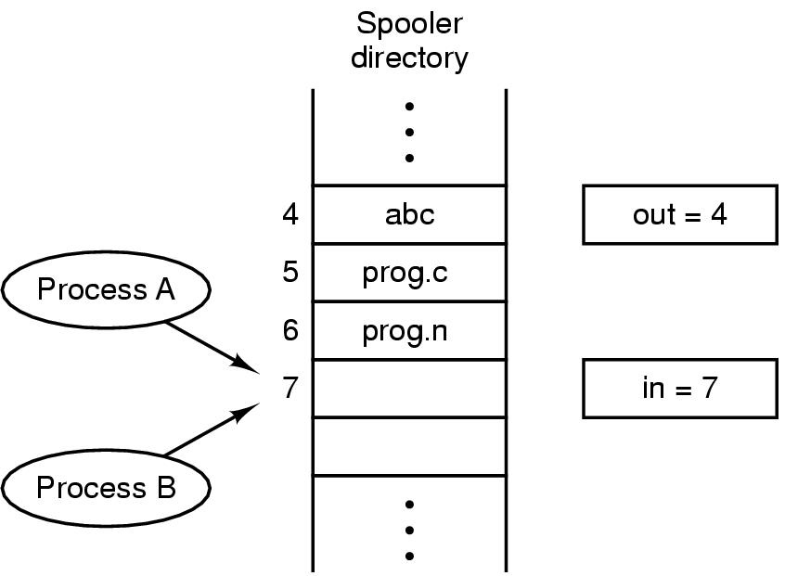
Race Conditions
A process that wants to print enters the name of the file into a print directory.
A print daemon (printd) periodically checks the directory, prints out the next file and removes its entry.
Two variables keep track of this queue:
  IN: Next available slot.
  OUT: Next file for printing.

Slide 8
Race Conditions
The following can happen:
  Process A reads IN as 7 and stores it in a local variable next.
  The OS pre-empts A and starts B.
  B reads IN as 7 and stores it in a local variable next.
  B inserts its file into slot 7 and updates IN to 8.
  B is pre-empted and A restarts.
  A still thinks slot 7 is available and inserts its file there, overwriting B’s file, then updates IN to 8.
The daemon is unaware of the mistake, and B never gets a printout. ☹

Slide 9
Critical Sections
To prevent race conditions, we must prevent two processes from reading/writing shared resources at the same time.
This is known as a “mutual exclusion”, shortened to “mutex”.
Conceptually, a RUNNING process is always in one of two possible states:
  It is performing local computation. This does not involve global storage, hence no race condition is possible.
  It is reading/updating global variables. This can lead to race conditions.
When a RUNNING process is in the second state, it is within its “critical section”.

Slide 10
Critical Sections
To prevent race conditions, 4 rules must be followed:
  No two processes can simultaneously be in their critical section.
  No assumptions may be made about speeds or # of CPUs.
    Note: We can relax this assumption for most embedded systems since they have single CPUs.
    May apply to systems using multicore microcontrollers.
  No process outside of its critical section can block other processes.
  No process should wait forever to enter its critical section.

Slide 11
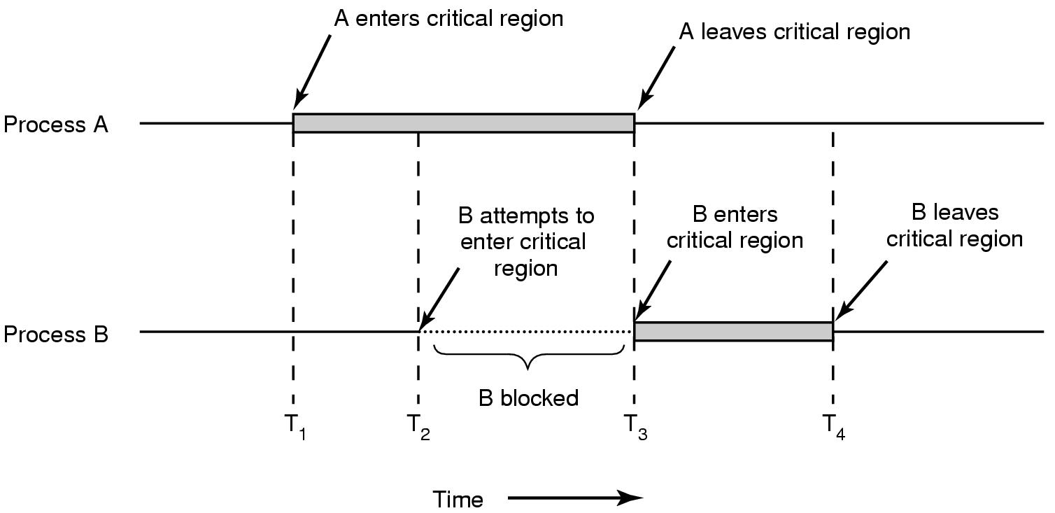
Critical Sections
In an ideal state, this is how mutual exclusion works:

Slide 12
Implementing mutual exclusion
Inter-Process Communications

Slide 13
Implementing Mutual Exclusion
There are several ways of implementing mutexes, each with their own + and – points. We will focus on two:
  Test and set lock.
  Sleep/Wakeup

Slide 14
Test and Set Lock
Many microprocessors have an instruction that looks like this:
  TSL reg, lock ; lock is a variable in memory
How this works:
  CPU locks the address and data buses, and reads “lock” from memory.
    The locked address and data buses will block accesses from all other CPUs.
  The current value is written into register “reg”.
  A “1” (or sometimes “0”) value is written to “lock”.
  CPU unlocks the address and data buses.
The TSL is “atomic”.
  This means that NOTHING can interrupt execution of this instruction.
  This is guaranteed in hardware.

Slide 15
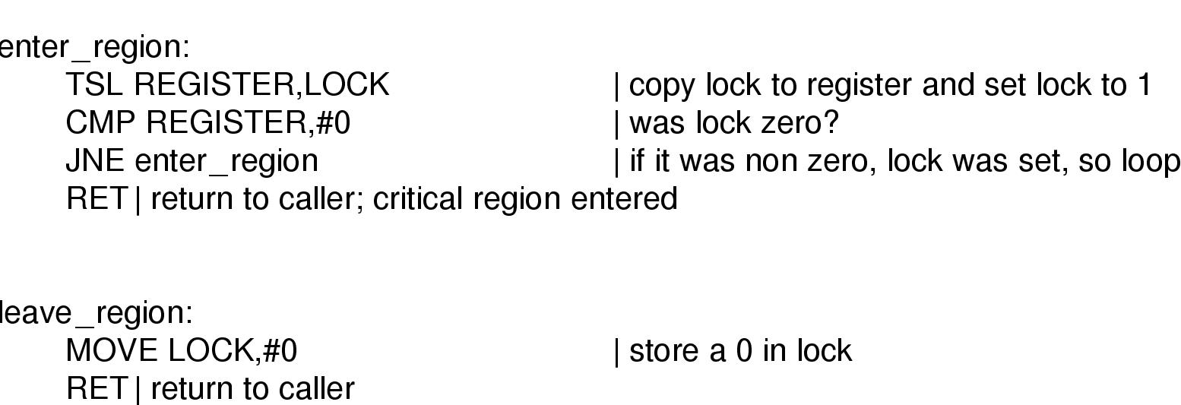
Test and Set Lock
The TSL instruction is used as follows:

Slide 16
Deadlock
Busy-wait approaches like TSL have a problem called “deadlock”.
Consider two processes H and L, and a scheduler rule that says that H is always run when it is READY. Suppose L is currently in the critical region.
  H becomes ready, and L is pre-empted.
  H tries to obtain a lock, but cannot because L is in the critical region.
  H loops forever, and CPU control never gets handed to L.
  As a result L never releases the lock.

Slide 17
Sleep/Wake
One solution to this problem is through the use of “Sleep/Wake” functions.
  When a process finds that a lock has been set (i.e. another process in the critical section), it calls “sleep” and is put into the blocked state.
  When the other process exits the critical section and clears the lock, it can call “wake” which moves the blocked process into the READY queue for eventual execution.
While this sounds like an ideal solution, it can create a problem called the “producer-consumer problem”.

Slide 18
The producer/consumer problem
Inter-Process Communications

Slide 19
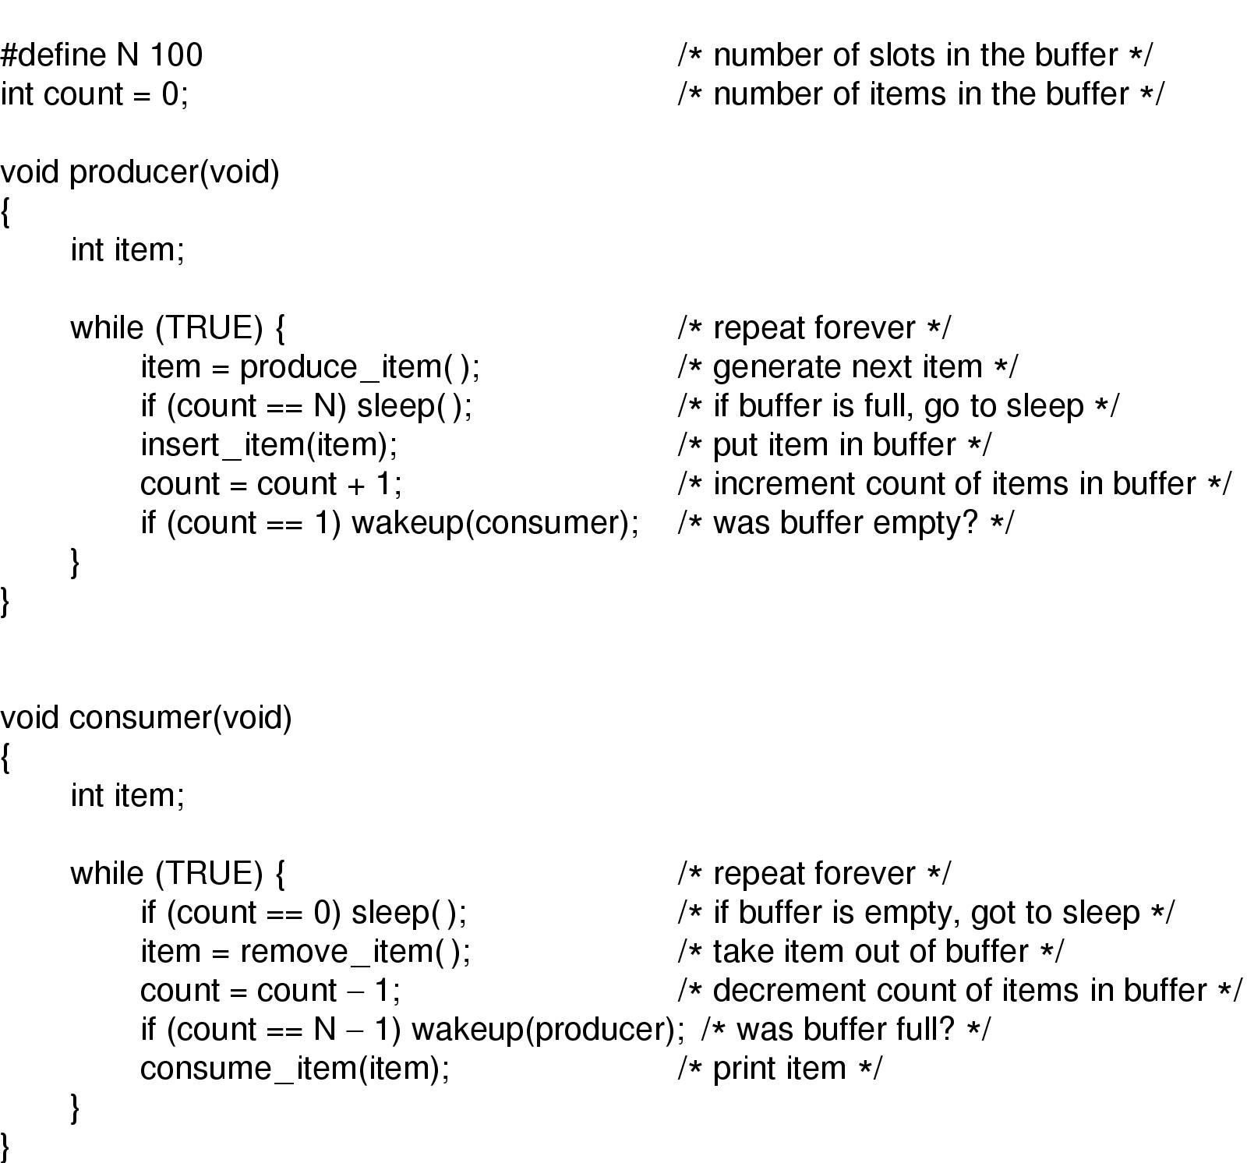
The Producer/Consumer problem

Slide 20
semaphores
Inter-Process Communications

Slide 21
Semaphores
A semaphore is a special lock variable that counts the number of wake-ups saved for future use.
  A value of “0” indicates that no wake-ups have been saved.
Two ATOMIC operations on semaphores:
  DOWN, TAKE, PEND or P:
    If the semaphore has a value of >0, it is decremented and the DOWN operation returns.
    If the semaphore is 0, the DOWN operation blocks.
  UP, POST, GIVE or V:
    If there are any processes blocking on a DOWN, one is selected and woken up.
    Otherwise UP increments the semaphore and returns.

Slide 22
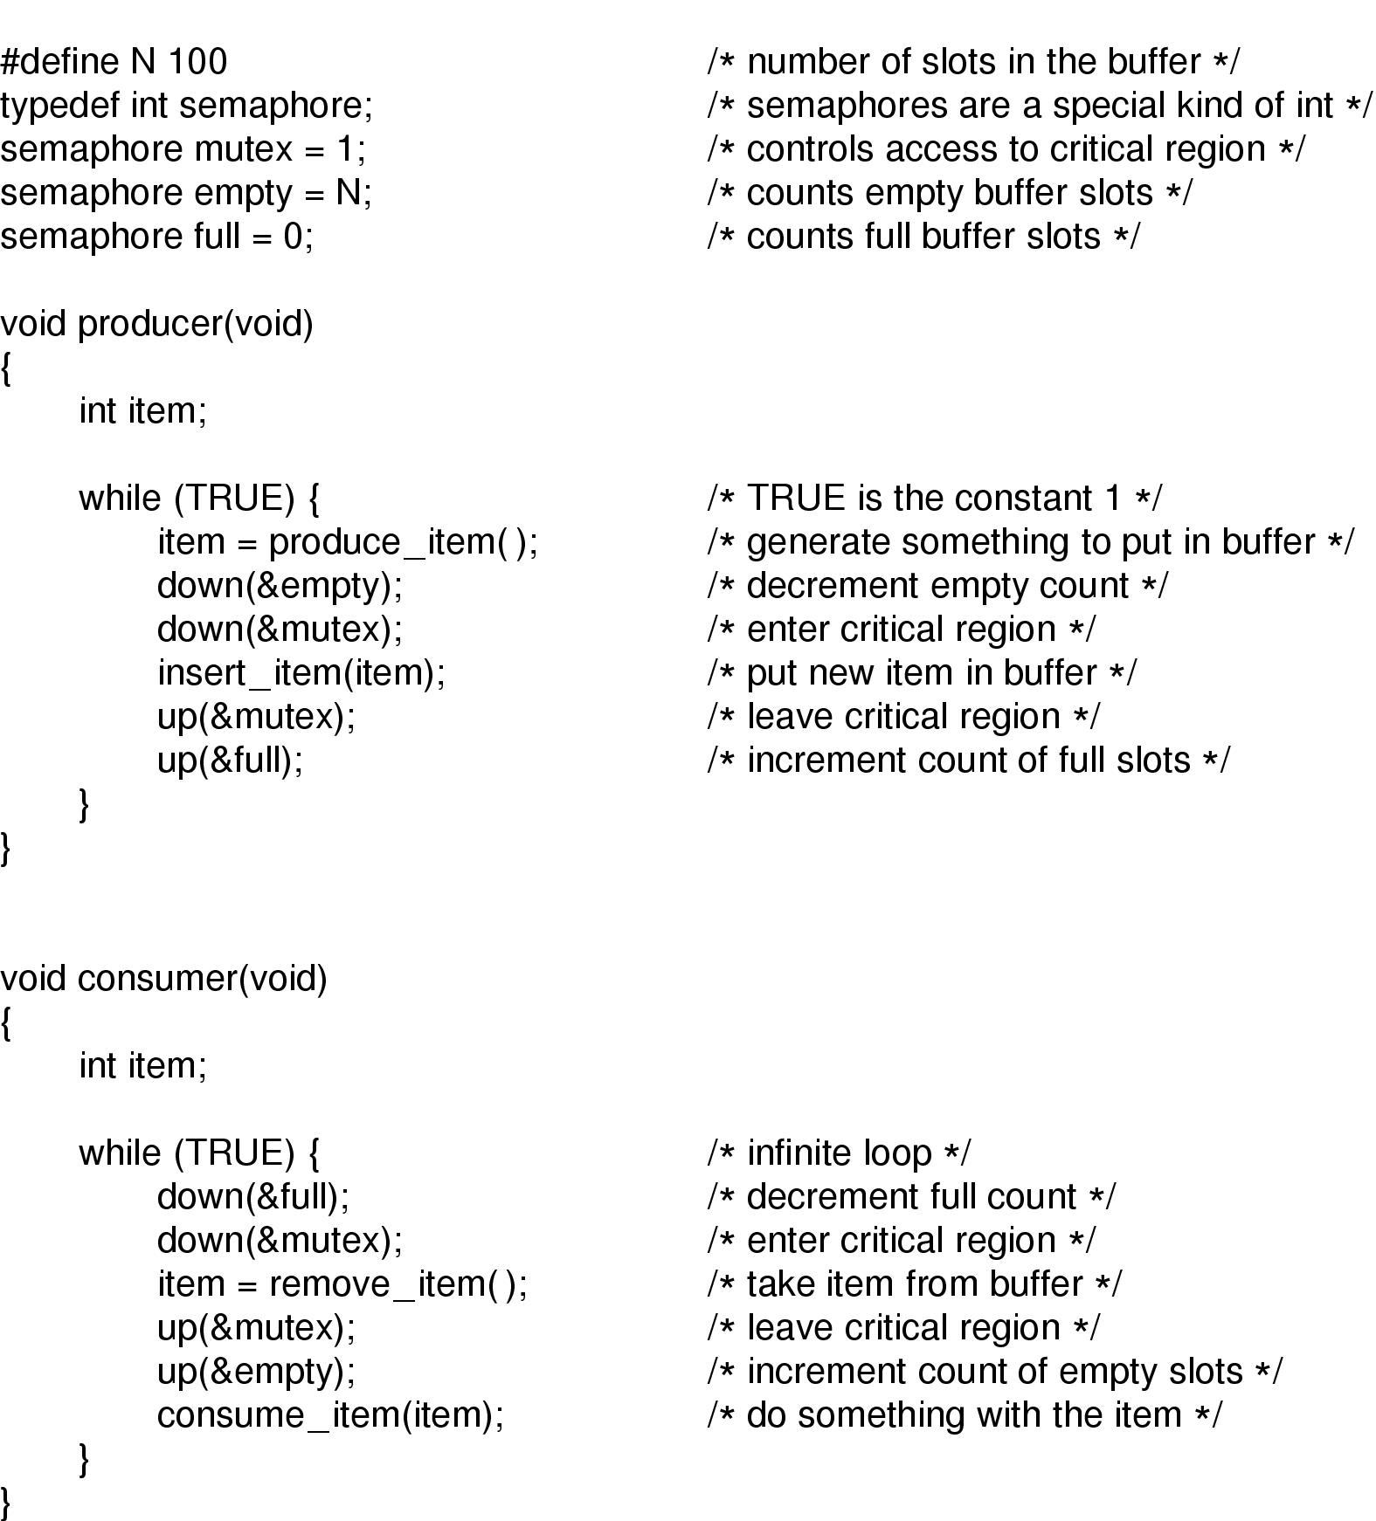
Using Semaphores in the Producer/Consumer Problem
EMPTY - # of empty slots.
FULL - # of full slots.
MUTEX – Prevents simultaneous access to the buffer.

Slide 23
Mutual Exclusion with Semaphores
When a semaphore’s counting ability is not needed, we can use a simplified version called a “mutex”.
  1 = Unlocked.
  0 = Locked.
Two processes can then attempt do DOWN the semaphore.
  Only one will succeed. The other will block.
  When the successful process exits the critical section, it does an UP, waking the other process up.

Slide 24
Mutual Exclusion with Semaphores
Process A
Process B
sema=1
…
non_critical_section()
DOWN(sema)
critical_section()
UP(sema)
…
non_critical_section()
DOWN(sema)
critical_section()
UP(sema)
…

Slide 25
Deadlocks with semaphores
Inter-Process Communications

Slide 26

Problems with Semaphores
Deadlock
Our producer/consumer solution has a problem:
  If we swapped the semaphores for empty/full with the mutex semaphore, we have a potential deadlock:

Slide 27
Problems with Semaphores
Deadlock
This can happen:
  Producer successfully DOWNs the mutex.
  Producer DOWNs “empty”. However the queue is full so this blocks.
  Consumer DOWNs mutex and blocks.
    Consumer now never reaches the UP for “empty” and therefore cannot unblock the producer.
    The producer in turn never reaches the UP for mutex and cannot unblock the consumer.
    Deadlock!

Slide 28
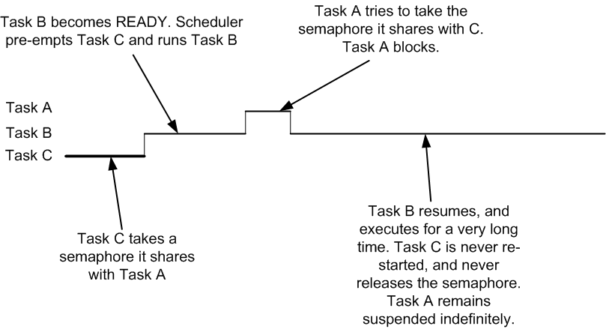
Problems with Semaphores
Priority Inversion
In the diagram on the following page, priority(Process C) < priority(Process B) < priority(Process A).
Process B effectively blocks out Process A, although Process A has higher priority!

